Slide 1
Edge Detection
Chul Min Yeum
Assistant Professor
Civil and Environmental Engineering
University of Waterloo, Canada
CIVE 497 – CIVE 700: Smart Structure Technology
Last updated: 2020-02-09

Slide 2
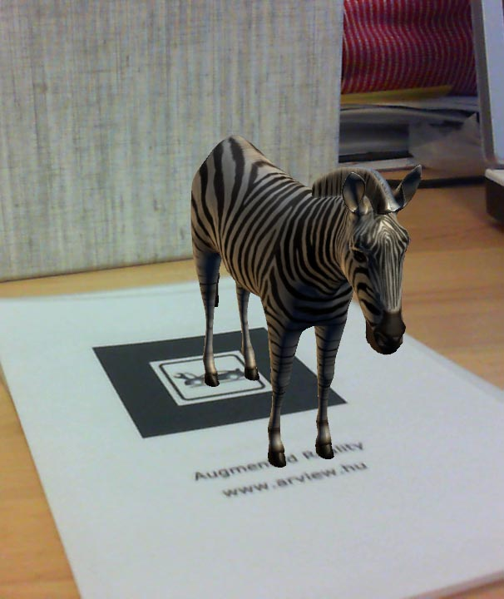
Edge Detection Applications
Crack detection
Augmented reality

Slide 3
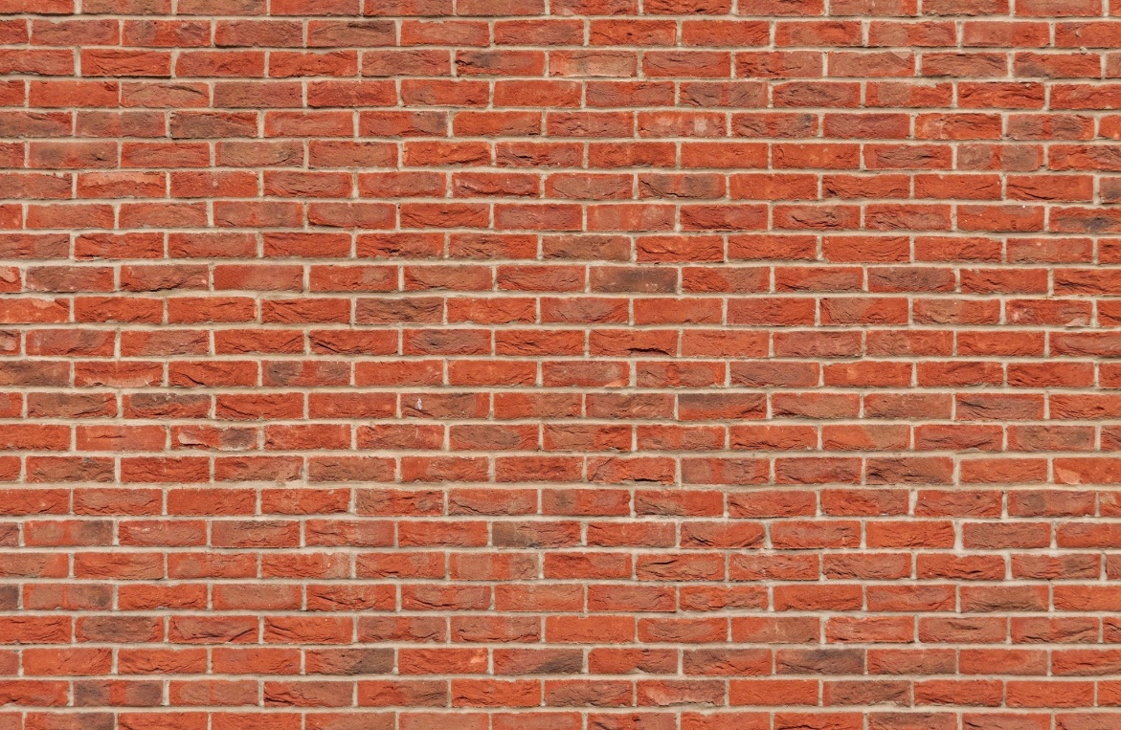
Edge Detection
Convert a 2D image into a set of curves
Semantic and shape information
More compact than pixels

Slide 4
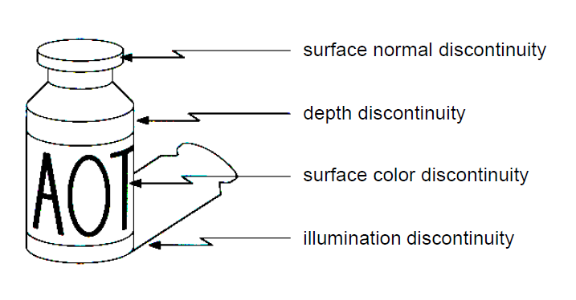

Origin of Edges
Surface normal discontinuity
Material discontinuity
Lighting discontinuity
Notes:
https://www.pexels.com/photo/clear-glass-window-with-brown-and-white-wooden-frame-921294/

Slide 5
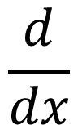
Characterizing Edge by Differentiation
An edge is a place of rapid change in the image intensity function in a single direction.
Edges correspond to extrema of derivative
$$\frac{d}{dx}$$
Intensity function
along a red line
Image
First derivative

Slide 6
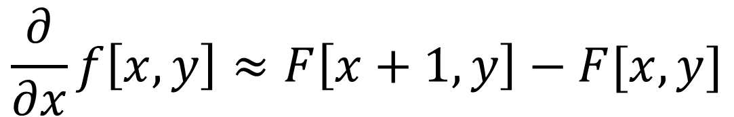
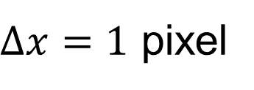
Image Derivatives
How can we differentiate a digital image $F[x,y]$?
Option 1: Reconstruct a continuous image, f, then compute the derivative
Option 2: Take discrete derivative (finite difference)
$$\frac{∂}{∂x}f\left[x,y\right]≈F\left[x+1,y\right]−F[x,y]$$
$∆x=1$ pixel
How would you implement this as a kernel?

Slide 7

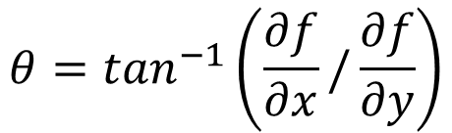
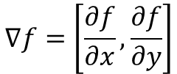
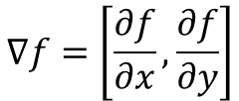
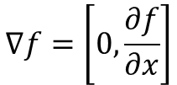
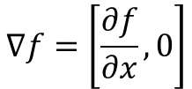
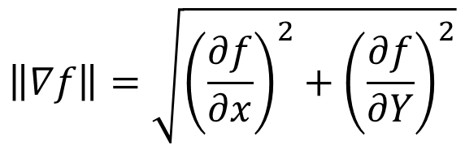
Image Gradient
The gradient of an image:
$$∇f=\left[\frac{∂f}{∂x},\frac{∂f}{∂y}\right]$$
$$∇f=\left[\frac{∂f}{∂x},0\right]$$
$$∇f=\left[0,\frac{∂f}{∂x}\right]$$
$$∇f=\left[\frac{∂f}{∂x},\frac{∂f}{∂y}\right]$$
$$θ$$
The gradient points in the direction of most rapid increase in intensity
The gradient direction is given by
The edge strength is given by the gradient magnitude
$$θ=\tan^{−1}\left(\frac{∂f}{∂x}/\frac{∂f}{∂y}\right)$$
$$\left\|∇f\right\|=\sqrt{{\left(\frac{∂f}{∂x}\right)}^{2}+{\left(\frac{∂f}{∂Y}\right)}^{2}}$$

Slide 8

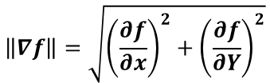


Example: Image Gradient
$$f$$
$$∂f/∂x$$
$$∂f/∂y$$
$$\left\|∇f\right\|=\sqrt{{\left(\frac{∂f}{∂x}\right)}^{2}+{\left(\frac{∂f}{∂Y}\right)}^{2}}$$

Slide 9
Intensity Changes on an Image

Slide 10
Intensity Changes on an Image (with Noise)

Slide 11
Effects of Noise
Noisy input image
Where is the edge?

Slide 12



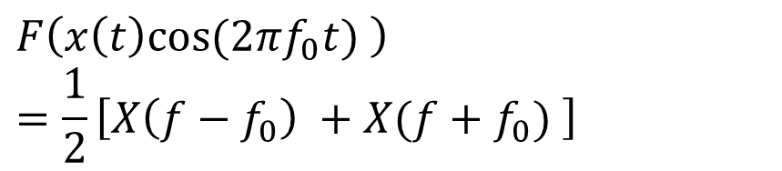

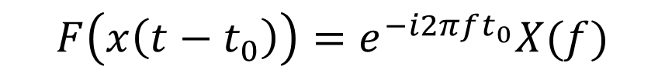
(Review) Properties of Fourier Transforms
1. Time scaling
2. Time reversal
$$F\left(x\left(at\right)\right)=\frac{1}{\left|a\right|}X(\frac{f}{a})$$
$$F\left(x\left(−t\right)\right)=X(−f)$$
3. Differentiation
Inverse spreading relationship
5. Modulation
$$F\left(\dot{x}\left(t\right)\right)=i2πfX(f)$$
$$F\left(x\left(t\right)e^{i2πf_{0}t}\right)=X(f−f_{0})$$
4. Time shifting
$$F\left(x\left(t\right)cos⁡(2πf_{0}t) \right)=\frac{1}{2}\left[X\left(f−f_{0}\right) +X(f+f_{0}) \right]$$
$$F\left(x\left(t−t_{0}\right)\right)=e^{−i2πft_{0}}X(f)$$
Only phase shift !
Sine wave

Slide 13
Smoothing First and Applying a Derivative Operator

Slide 14
Smoothing First and Applying a Derivative Operator (Continue)
Relationship with differentiation: ${\left(F∗H\right)}^{′}=F^{′}∗H=F∗H′$
$${\left(f∗h\right)}^{′}=f∗h′$$
What is the advantage?

Slide 15
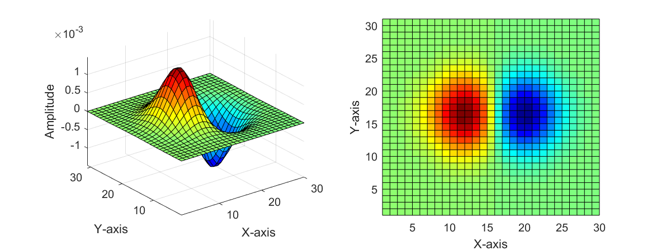
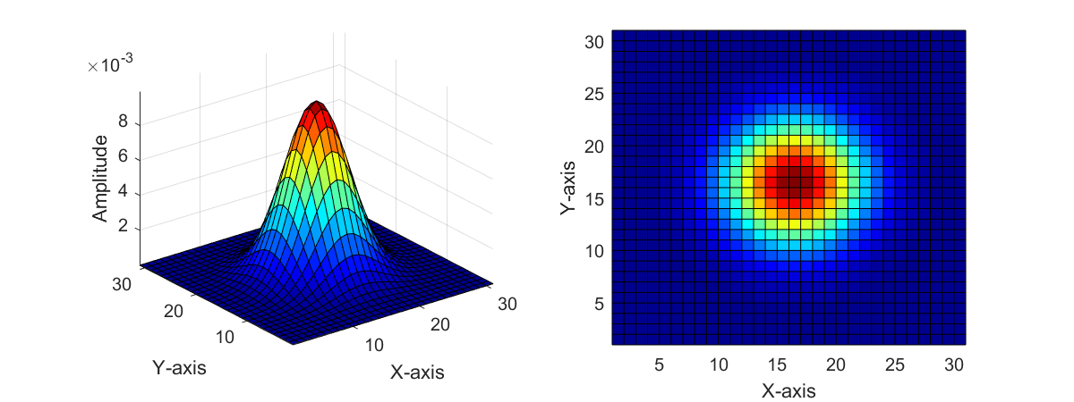
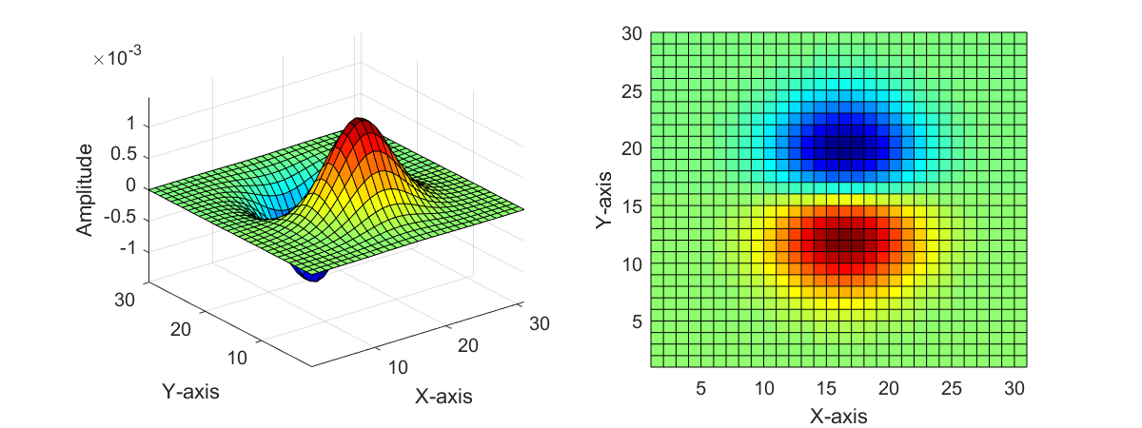
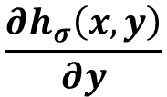
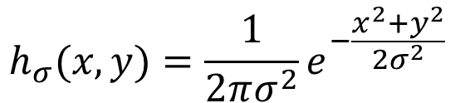
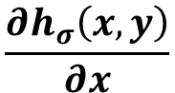
2D Edge Detection Filter
$$\frac{∂h_{σ}\left(x,y\right)}{∂x}$$
$$h_{σ}(x,y)=\frac{1}{2πσ^{2}}e^{−\frac{x^{2}+y^{2}}{2σ^{2}}}$$
$$\frac{∂h_{σ}\left(x,y\right)}{∂y}$$
Gaussian kernel
Derivative of Gaussian filter

Slide 16
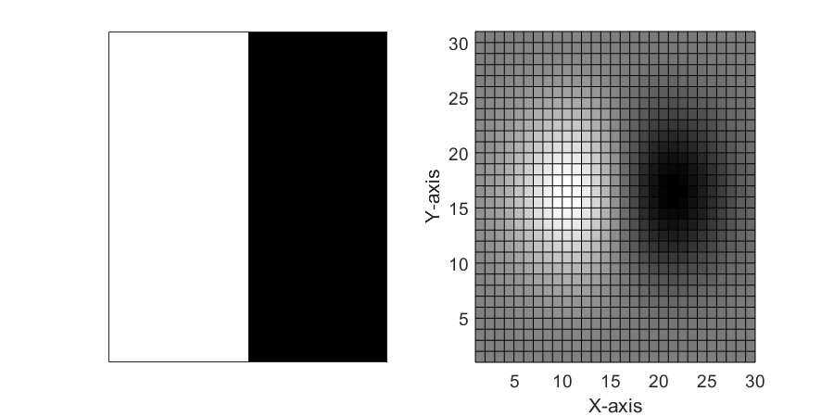
2D Edge Detection Filter (Continue)
-1 | 0 | 1
-1 | 0 | 1
-1 | 0 | 1
?
Prewitt operator

Slide 17


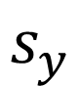
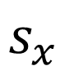
Sobel Operator
Common approximation of derivative of Gaussian
-1 | 0 | 1
-2 | 0 | 2
-1 | 0 | 1
1 | 2 | 1
0 | 0 | 0
-1 | -2 | -1
$$\frac{1}{8}$$
$$\frac{1}{8}$$
$$s_{x}$$
$$s_{y}$$
The Sobel operator omits the 1/8 term because it does not make a difference for edge detection

Slide 18
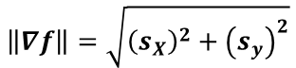


Sobel Operator (Example)
$$f$$
$$s_{x}$$
$$s_{y}$$
$$\left\|∇f\right\|=\sqrt{{\left(s_{X}\right)}^{2}+{\left(s_{y}\right)}^{2}}$$

Slide 19
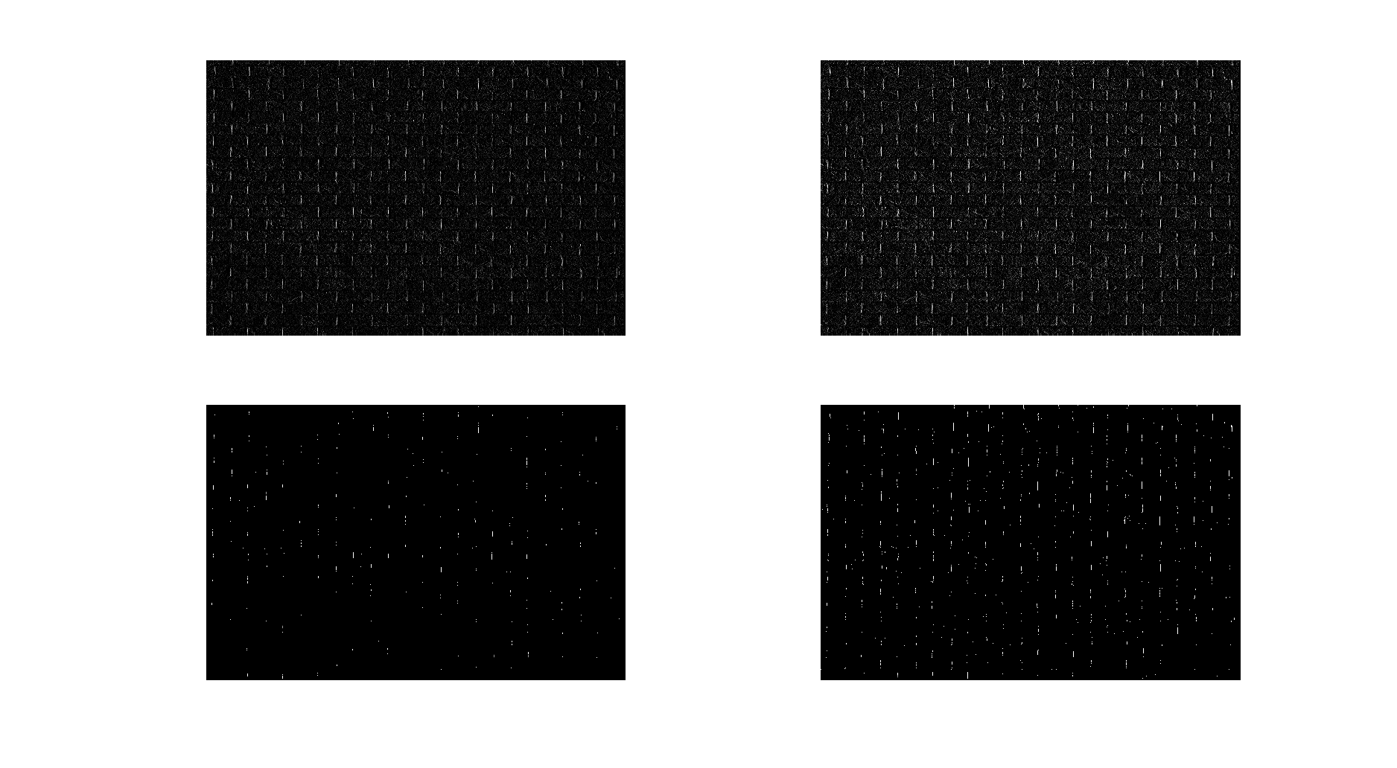




Comparison of Derivative Operators (Prewitt and Sobel)
$$f_{x}$$
$$s_{x}$$
$$f_{x}>0.75$$
$$s_{x}>0.75$$

Slide 20
Laplacian of Gaussian (1D Example)

Slide 21
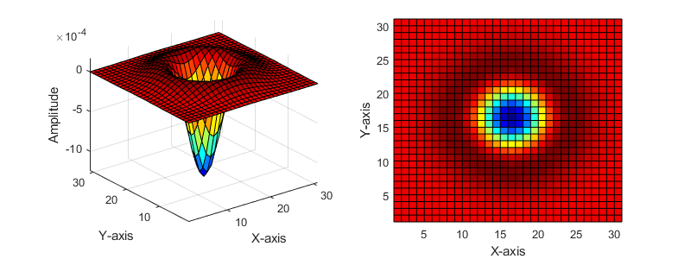
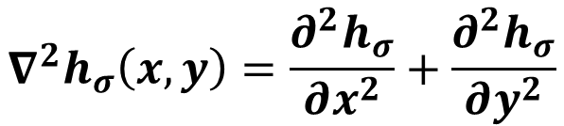
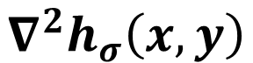
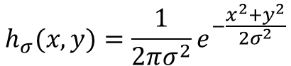
Laplacian of Gaussian
$$∇^{2}h_{σ}\left(x,y\right)$$
0 | -1 | 0
-1 | 4 | -1
0 | -1 | 0
$$∇^{2}h_{σ}\left(x,y\right)=\frac{∂^{2}h_{σ}}{∂x^{2}}+\frac{∂^{2}h_{σ}}{∂y^{2}}$$
$$h_{σ}(x,y)=\frac{1}{2πσ^{2}}e^{−\frac{x^{2}+y^{2}}{2σ^{2}}}$$

Slide 22
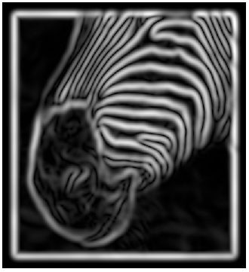
Implementation Issues for Gradient-based Edge Detection
The gradient magnitude is large along a thick “trail” or “ridge,” so how do we identify the actual edge points?
How do we link the edge points to form curves?

Slide 23
Canny Edge Detector
This is probably the most widely used edge detector in computer vision
Theoretical model: step-edges corrupted by additive Gaussian noise
J. Canny, A Computational Approach To Edge Detection, IEEE Trans. Pattern Analysis and Machine Intelligence, 8:679-714, 1986.
Steps
Filter image with x, y derivatives of Gaussian
Find magnitude and orientation of gradient
Non-maximum suppression: Thin multi-pixel wide “ridges” down to single pixel width
Thresholding and linking (hysteresis): Define two thresholds: low and high and use the high threshold to start edge curves and the low threshold to continue them
MATLAB: edge(image, ‘canny’)

Slide 24
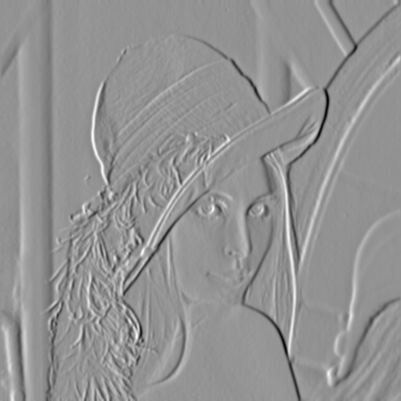
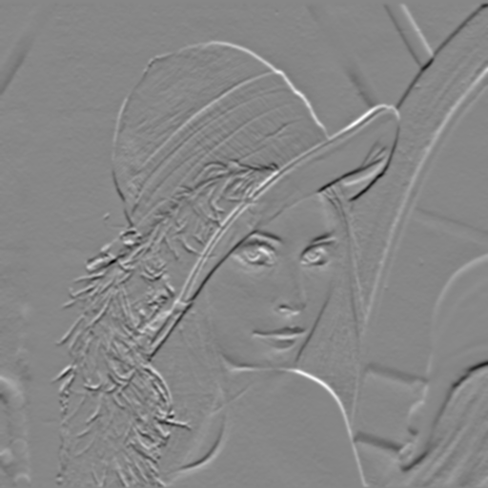

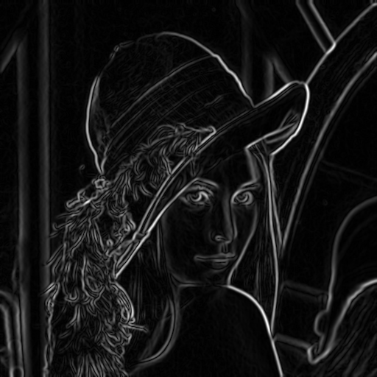
Original Image and Its Gradient
original image (Lena)
X-Derivative of Gaussian
Y-Derivative of Gaussian
Gradient Magnitude

Slide 25
Finding Edges

Slide 26

Non-maximum Suppression
Check if pixel is local maximum along gradient direction
Requires interpolating pixels p and r

Slide 27
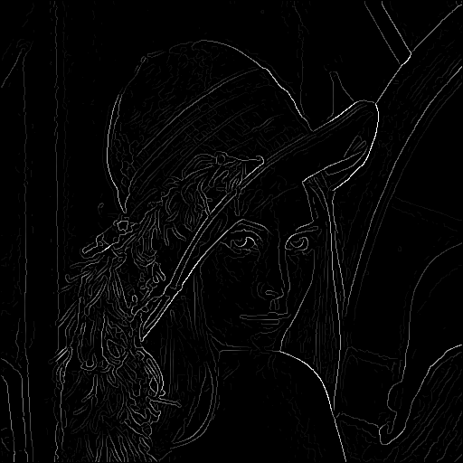
After Non-maximum Suppression

Slide 28
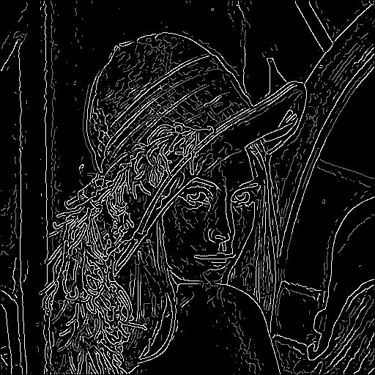
Hysteresis Thresholding
Threshold at low/high levels to get weak/strong edge pixels
Do connected components, starting from strong edge pixels

Slide 29
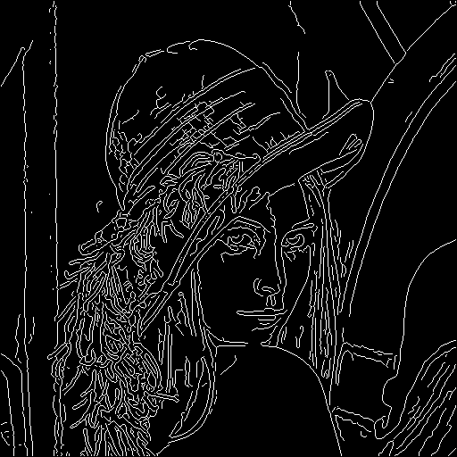
Final Canny Edges

Slide 30
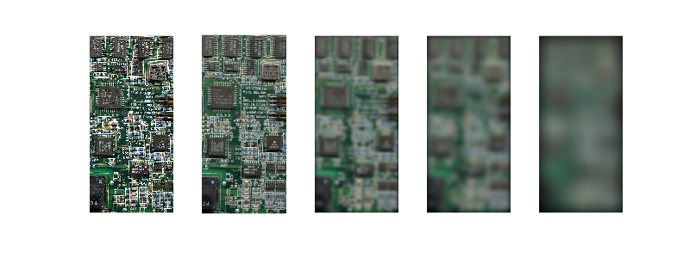
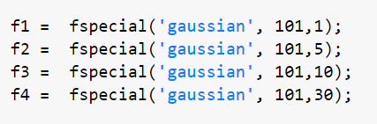
(Revisit) Effect of Gaussian Window Sizes

Slide 31
Effect of σ (Gaussian Kernel Size)
The choice of σ depends on desired behavior
large σ detects large scale edges
small σ detects fine features

Slide 32
Effect of High and Low Thresholds
[0.4 0.8]
[0.4 0.5]
[0.2 0.5]
[0.1 0.5]

Slide 33
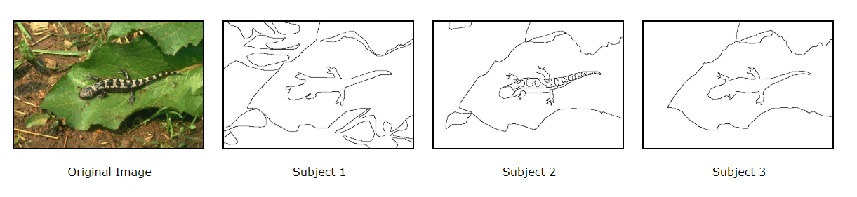
Contour Detection and Image Segmentation Resources (Computer Vision Group in Berkeley)

Slide 34
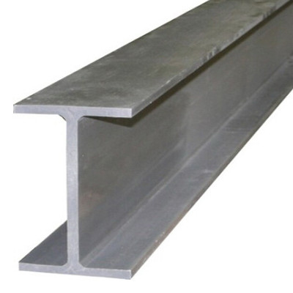
Hough Transform
The basic idea is to examine the parameter space for lines, rather than the image spaces.

Slide 35
Image and Parameter Spaces
Equation of Line:
Find:
Consider point:
Parameter space also called Hough Space
Image Space
Image Space
Parameter Space
Parameter Space

Slide 36
Line Detection by Hough Transform
Algorithm:
Quantize Parameter Space
Create Accumulator Array
Set
For each image edge increment:
If lies on the line:
Find local maxima in
Parameter Space
 | 1 |  |  |  |  |  | 1
 |  | 1 |  |  |  | 1
 |  |  | 1 |  | 1
 |  |  |  | 2
 |  |  | 1 |  | 1
 |  | 1 |  |  |  | 1
 | 1 |  |  |  |  |  | 1

Slide 37
Better Parameterization
NOTE:
Large Accumulator
More memory and computations
Improvement:
Line equation:
Here
Given points find
(Finite Accumulator Array Size)
Image Space
?
Hough Space Sinusoid
Hough Space

Slide 38
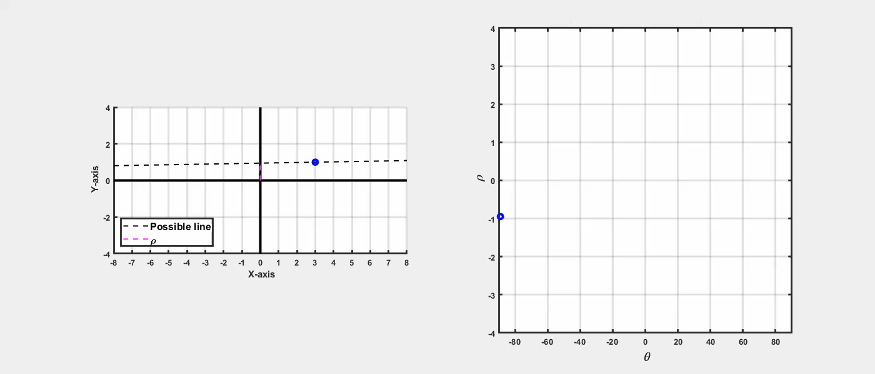
Hough Transform Demo

Slide 39
Example: Line Passing Through Three Dots
-70°
60°

Slide 40
Example: Line Detection
1st Peak

Slide 41
Mechanics of the Hough Transform
Difficulties
how big should the cells be? (too big, and we merge quite different lines; too small, and noise causes lines to be missed)
How many lines?
Count the peaks in the Hough array
Treat adjacent peaks as a single peak
Which points belong to each line?
Search for points close to the line
Solve again for line and iterate

Slide 42
Slide Credits and References
Lecture notes: S. Narasimhan
Lecture notes: Gordon Wetzstein
Lecture notes: Noah Snavely
Lecture notes: L. Fei-Fei
Lecture notes: D. Frosyth
Lecture notes: James Hayes
Lecture notes: Yacov Hel-Or

